Slide 1

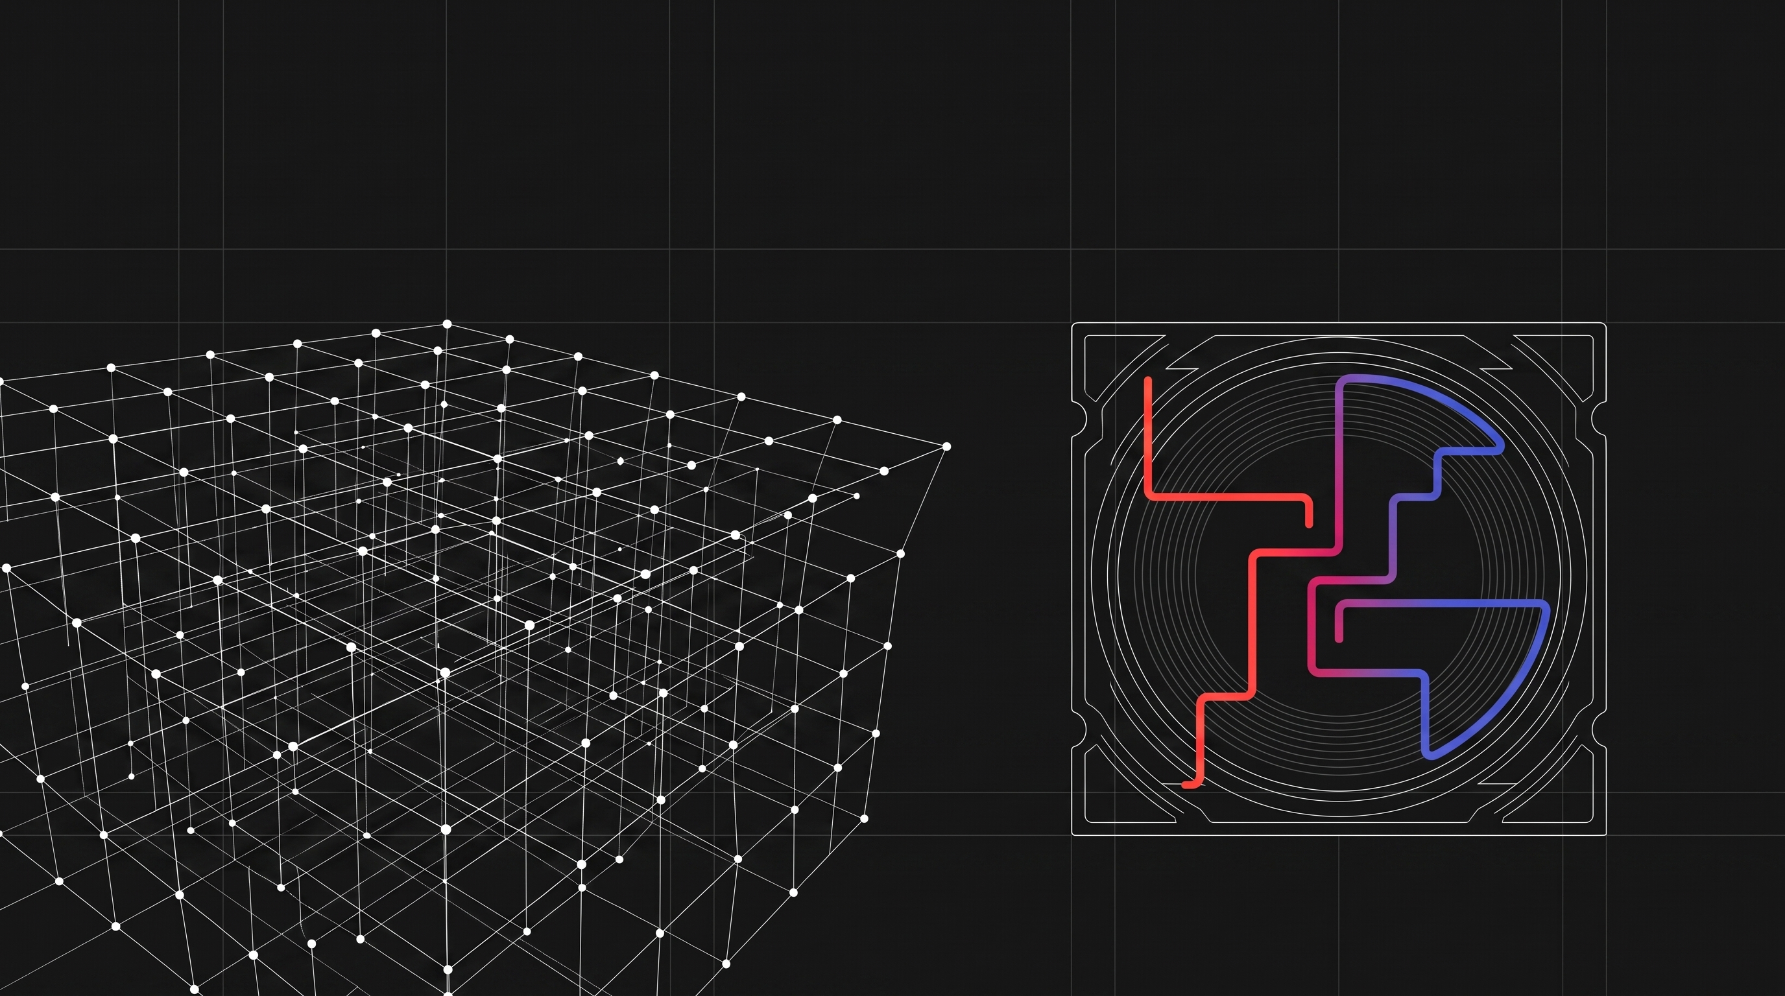
Post-quantum TLS acceleration
Experiment plan, methodology, and measurement set
Isolating the contribution of Intel QAT, AVX-512, and GPU batching to TLS 1.3 handshake rate and bulk throughput
Draft 2026-08-18
Notes:
Scope: server-side TLS termination on Xeon 6 with integrated QAT, plus an optional GPU arm. Aim is attribution of gains, not a marketing number.

Slide 2
What the experiment must answer
Each question maps to exactly one pair of arms differing by one variable
Transition cost
1
What does hybrid post-quantum TLS cost per core against a classical TLS 1.3 baseline, in handshakes per second and in cycles per handshake?
QAT recovery
2
Intel QAT accelerates only the classical leg of a hybrid handshake. How much of the transition cost does that offload recover?
AVX-512 uplift
3
What do AVX-512 optimised ML-KEM and ML-DSA kernels add over a generic build of the same primitives?
GPU batching
4
Does batched ML-KEM and ML-DSA on the GPU beat AVX-512 once queueing latency is charged to the p99?
Every arm SHOULD be reducible to one of these four questions. An arm that answers none of them SHOULD be cut from the matrix.
Notes:
RFC 2119 language is deliberate. The single-variable rule is what makes the deltas attributable.

Slide 3
Configuration matrix
Five arms. Adjacent arms differ by one controlled variable
Arm | Key exchange | Authentication | Intel QAT | PQC engine
A1 | X25519 | RSA-3072 and ECDSA P-256 | Enabled | not applicable
B1 | X25519MLKEM768 | RSA-3072 and ECDSA P-256 | Disabled | CPU, AVX-512
B2 | X25519MLKEM768 | RSA-3072 and ECDSA P-256 | Enabled | CPU, AVX-512
C1 | ML-KEM-768 only | ML-DSA-65 chain | Disabled | CPU, AVX-512
D1 | X25519MLKEM768 | RSA-3072 and ECDSA P-256 | Enabled | GPU, batched
A1 to B2
Transition cost of hybrid PQC with the accelerator already engaged
B1 to B2
QAT contribution in isolation. Identical cryptography, offload toggled
B2 to C1
Cost of removing the classical leg entirely, which also removes all QAT work
B2 to D1
GPU contribution in isolation. Identical cryptography, PQC engine swapped
Hybrid signature schemes remain IETF drafts, so each arm records its certificate chain construction explicitly rather than assuming a composite certificate.
Notes:
C1 exists to bound the pure-PQC case. D1 is the only arm that needs the GPU, so it runs last.

Slide 4
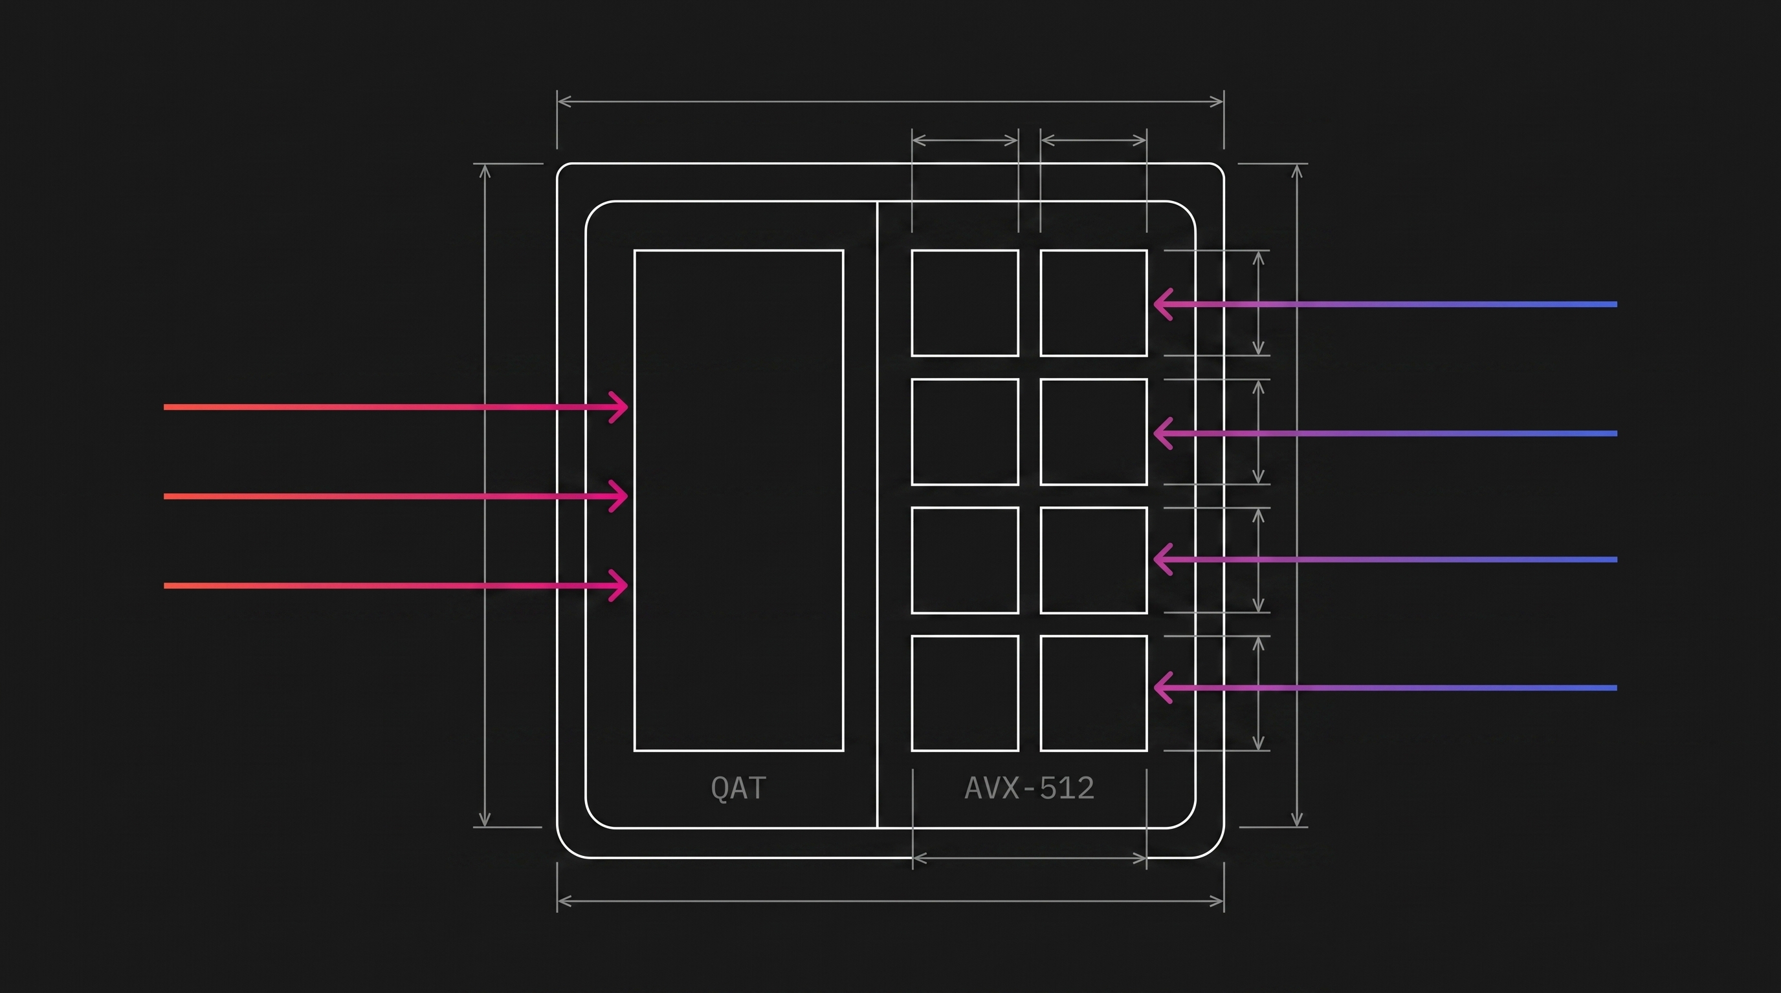
Where the work actually lands
The accelerator has no lattice datapath, so the split is fixed before any tuning begins
Fixed by architecture
The accelerator public-key unit performs modular arithmetic on large integers, which covers RSA, ECDH and ECDSA
ML-KEM and ML-DSA need small-modulus number theoretic transforms and Keccak sampling, which that unit cannot express
Post-quantum operations therefore stay on the core, or move to the GPU, in every arm
Offload also has to earn its transport cost, and the lattice operations are too cheap for it to do so
Arms B1 and B2 differ only in whether the classical leg is offloaded, which is what makes the pair interpretable.
Notes:
This slide answers the question people ask first: why is there no post-quantum offload column.

Slide 5
System under test
Every version and firmware setting is recorded per run, not per campaign
Platform
Software stack
Fixed controls
Xeon 6 SoC with integrated QAT, model and stepping
Core count, SMT state
Turbo policy and any frequency pin
C-state and P-state governor
Hardware prefetcher settings
NUMA node count and snoop mode
DDR5 population and speed
NIC model, port count, link rate
PCIe generation and lane width per device
RTX 6000 Pro, slot and root complex
Distribution and kernel build
Intel QAT out-of-tree driver version
QAT device configuration file in use
QAT_Engine build, provider mode
OpenSSL version and provider list
liboqs version, minimum 0.14.0
oqs-provider version
NGINX version and worker model
cuPQC and CUDA driver versions
Load generator build and version
TLS 1.3 only, one cipher suite
Session resumption and tickets off
OCSP stapling off
HTTP keep-alive off for handshake runs
Identical certificate key sizes across arms
Interrupt affinity and RPS map pinned
Firewall and conntrack disabled on path
Same client fleet for every arm
Ambient inlet temperature logged
Idle baseline captured before each arm
A run whose manifest is incomplete is discarded rather than corrected after the fact. Firmware and driver revisions are captured by script, not by hand.
Notes:
Published vendor results have been produced on liboqs 0.10.1, which predates the AVX-512 contributions. Version capture is not bookkeeping, it changes the answer.

Slide 6
Workloads
Three workloads. Handshake rate is the primary, the other two guard against a misleading headline
Handshake rate
W1
Full TLS 1.3 handshakes with no application payload. Resumption disabled so every connection pays the asymmetric cost. Reported as connections per second per core, then per socket.
Primary metric for arms A1, B1, B2, C1
Bulk throughput
W2
Repeated GET of a 10 MB object over established sessions. Exercises the record layer and AES-256-GCM rather than the key exchange.
Detects whether an arm trades handshake gain for record-layer loss
Handshake latency
W3
Sequential single-connection handshakes at low concurrency, then at target concurrency. Full distribution, not an average.
The only workload that exposes GPU batching cost in arm D1
Notes:
W3 is the slide that stops a GPU arm from being declared a win on throughput alone.

Slide 7
Run protocol
The procedure is fixed before the first measurement and does not change mid-campaign
1
Warm up
4
Randomise
30 seconds of load discarded before any counter is read. Accelerator rings and page cache MUST be warm.
Arm order is shuffled across repetitions so thermal drift does not correlate with arm identity.
2
Measure
5
Restart
300 seconds of steady-state load per run. Telemetry collection starts before load and stops after it.
Service and driver state reset between arms. Confirm the idle baseline returns before the next run.
3
Repeat
6
Prove headroom
Five runs per arm. Report median with interquartile spread. Never report a single best run.
Client fleet doubled on one run per arm. If the result moves, the client was the bottleneck and the run is void.
Notes:
The randomisation and client-headroom checks are the two steps most often skipped and the two that most often invalidate a campaign.

Slide 8
Cryptographic metrics
Recorded at both the connection level and the primitive level so results can be attributed
Connection level
Primitive level
Connections per second, per core and per socket.
Handshake latency at p50, p95, p99, p99.9.
Bulk throughput in Gbps and Gbps per core.
Failed and renegotiated handshake count.
Bytes on the wire per handshake, by flight.
TCP segments and retransmissions per handshake.
ML-KEM-768 keygen, encapsulate, decapsulate.
ML-DSA-65 keygen, sign, verify.
ML-DSA sign rejection-loop iteration count.
RSA-3072 sign and verify.
X25519 and P-256 ECDH.
AES-256-GCM at 1 KB, 8 KB, 64 KB records.
Primitive costs are captured on the same host, in the same session, as the connection-level run
openssl speed -provider oqsprovider -kem-algorithms
openssl speed -provider oqsprovider -signature-algorithms
openssl speed -provider qatprovider -async_jobs 72 rsa3072 ecdsap256
openssl speed -evp aes-256-gcm -bytes 1024,8192,65536
openssl s_time -connect $DUT:443 -new -time 300 -verify 0 -groups X25519MLKEM768
Primitive results are the consistency check on the connection-level results. A handshake rate that cannot be reconstructed from the primitive costs plus protocol overhead indicates a measurement fault.
Notes:
Report ML-DSA sign as a distribution. The rejection sampling loop gives it a right-skewed tail that a mean hides.

Slide 9
CPU and memory telemetry
Cycles per handshake is the comparable unit across arms. Everything here feeds it or explains it
Core utilisation
Execution efficiency
Per-core busy percentage, user against kernel split, softirq and system time, context switches and involuntary migrations.
Instructions per cycle, retired instructions per handshake, branch mispredict rate, front-end and back-end stall breakdown.
Achieved frequency
Cache and memory
Actual core frequency under load, not the nameplate. Turbo licence level residency, since heavy AVX-512 use lowers the licence and the clock.
L1, L2 and last-level cache miss rates, memory read and write bandwidth, DRAM latency under load, page faults.
Power and thermals
NUMA behaviour
Package and core RAPL energy, DRAM energy, package temperature, any thermal or power throttle event count.
Remote memory access ratio, cross-socket traffic, worker to NIC queue locality.
Notes:
The turbo licence point matters: an AVX-512 heavy arm can post a lower clock than the classical baseline, which shows up as a regression that is really a frequency effect.

Slide 10
Accelerator and interconnect telemetry
Without these counters an offload run cannot be distinguished from a software fallback
Intel QAT
Requests submitted and completed per second per engine. Ring depth and occupancy. Submission retries and ring-full events. Polling against interrupt mode. Per-service breakdown for asymmetric, symmetric, and compression. Firmware counter deltas from device debug interfaces.
PCIe and fabric
Read and write bandwidth per device per direction. Transaction rate and average payload size. Completion latency. Any correctable error counter movement during a run.
GPU, arm D1 only
Streaming multiprocessor occupancy and kernel duration. Effective batch size actually dispatched against the configured maximum. Host to device and device to host copy volume. Submission queue depth and time spent waiting to fill a batch. Board power and memory clock.
Network path
Packets and bytes per second per queue. Interrupt rate per core. Receive queue drops. Segments per handshake, which rises sharply once post-quantum certificates fragment across frames.
Notes:
A QAT arm whose ring counters stay flat is a software run that has been mislabelled. That check gates acceptance of every offload result.

Slide 11
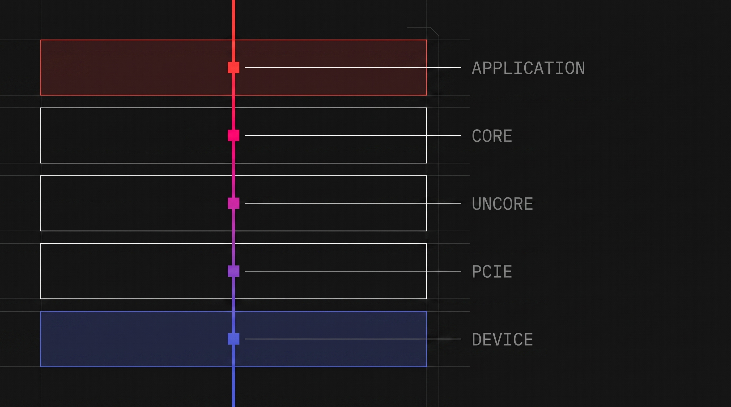
One handshake, five instrumented layers
A regression is only attributable if the same request is observable at every layer it touches
Application
Handshake outcome, latency, connection count
Core
Cycles, instructions per cycle, achieved frequency, cache behaviour
Uncore
Memory bandwidth, last-level cache traffic, cross-socket transfer
PCIe
Payload volume and completion latency per direction
Device
Accelerator ring occupancy, or GPU kernel duration and batch fill
A counter that cannot be joined to a specific run and a specific layer is telemetry that will not survive review.
Notes:
Layer joins are done on run identifier and timestamp, which is why the shared clock requirement is not optional.

Slide 12
Collection tooling and sampling
One NTP-synchronised clock. Every sample tagged with the run identifier
Tool | Captures | Interval | Runs on
perf stat, emon | Core counters, IPC, cache, stall breakdown | 1 s | Every run
turbostat | Achieved frequency, C-state residency, RAPL energy | 1 s | Every run
pcm, pcm-memory, pcm-pcie | Uncore, memory bandwidth, PCIe traffic | 1 s | Every run
mpstat, sar, /proc/interrupts | Per-core utilisation, softirq, interrupt distribution | 1 s | Every run
QAT device debug counters | Ring occupancy, request rate, retries | 5 s | QAT arms
nvidia-smi dmon, DCGM | GPU occupancy, power, copy volume, queue depth | 1 s | Arm D1
Load generator logs | Connections per second, latency histogram, errors | 1 s | Every run
perf record with call graph | Hotspot attribution and symbol-level cost | one run per arm | Profiling pass only
Sampling overhead is measured, not assumed. One arm is repeated with collection disabled; if handshake rate moves by more than two percent, the sampling interval is relaxed and the campaign restarts.
Notes:
Continuous perf record is deliberately excluded from measurement runs. It is a separate profiling pass.

Slide 13
Derived metrics and analysis
The raw counters are inputs. These are the numbers that answer the four questions
Derived metric | Definition | Answers
Cycles per handshake | Achieved frequency times active cores times busy fraction, divided by connections per second | Cross-arm comparison free of clock effects
Post-quantum tax | One minus the ratio of arm B2 to arm A1 handshake rate | Question 1, transition cost
QAT recovery ratio | Gain from B1 to B2 divided by the loss from A1 to B1 | Question 2, offload contribution
Kernel uplift | Handshake rate with optimised liboqs against a generic build of the same version | Question 3, AVX-512 contribution
Batch efficiency | Effective GPU batch size plotted against added p99 handshake latency | Question 4, GPU viability
Offload fidelity | QAT asymmetric operations per second divided by handshakes per second | Detects silent fallback to software
Handshakes per watt | Connections per second divided by package plus board power | Deployment economics
Bytes and segments per handshake | Wire volume and frame count per completed handshake | Explains loss on constrained paths
Offload fidelity has an expected value derived from the protocol, so a measured value below it is a defect in the configuration rather than a result about the hardware.
Notes:
Cycles per handshake is the number to lead with internally. Connections per second is the number for external comparison.

Slide 14
Validity controls
Each of these has silently invalidated a published acceleration result. All are checked per run
✓
Offload actually engaged
✓
No silent provider fallback
Accelerator request counters MUST increment in proportion to handshake count. A flat ring is a software run wearing the wrong label.
A missing algorithm in the selected provider MUST fail the handshake, not degrade to a default implementation. Verified by deliberately breaking one arm.
✓
Optimised kernels present
✓
Client is not the limit
The post-quantum library build is confirmed to contain the vectorised code paths. A generic build understates the result and looks like a hardware finding.
Doubling client capacity MUST not change the measured rate. Applies to every arm, not just the fastest.
✓
Frequency held constant
✓
Distributions, not means
Achieved clock is compared across arms before any rate is compared. A frequency difference is reported separately, never folded into the result.
Signature generation has a variable-iteration loop and GPU batching adds queueing, so both are reported as percentiles.
Notes:
Item two is worth doing on purpose once: break an arm deliberately and confirm it fails loudly.

Slide 15
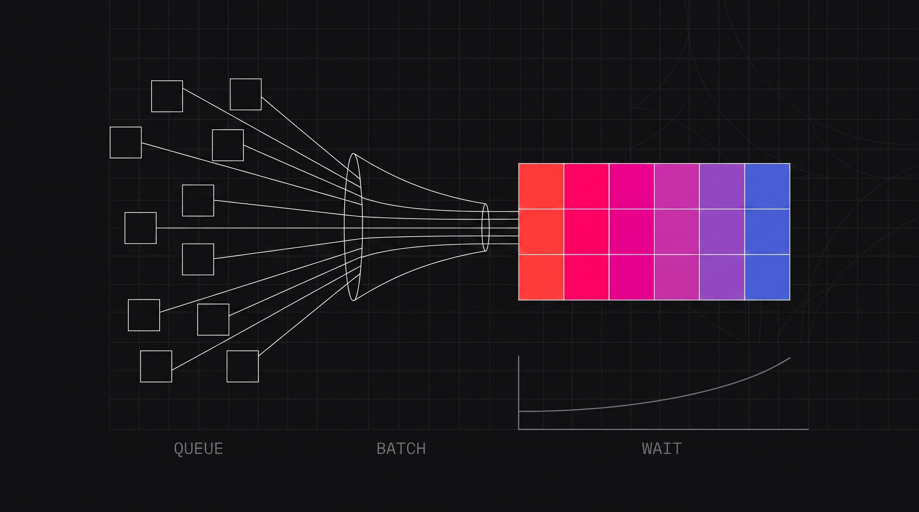
The GPU arm is a latency experiment
Throughput on the accelerator is not the question. The queue in front of it is
What arm D1 measures
Batched lattice operations only reach their published rates at large batch sizes
A TLS terminator must therefore hold connections in a queue until a batch fills
That wait is charged to first-byte latency, which is the one number a handshake exists to minimise
So the deliverable is a curve of batch size against p99 latency, not a single throughput figure
The arm passes only if a batch size exists where throughput rises and p99 does not
Report D1 separately from the CPU arms. It changes the latency contract, so it is not comparable on handshake rate alone.
Notes:
If no batch size satisfies both conditions, the honest finding is that the GPU arm does not apply to interactive TLS termination.

Slide 16
Published anchors for sanity checking
Vendor figures used only as order-of-magnitude checks. Every arm is measured independently
15% and 21%
2,926
9.0 million
Reported cost of moving to hybrid post-quantum key exchange against a classical baseline, for RSA and for ECDSA P-256 respectively, on a Xeon 6 SoC
Full post-quantum TLS handshakes per second on a single core with the highest parameter set, ML-DSA-87 with ML-KEM-1024
Batched ML-KEM-768 encapsulations per second on a datacentre GPU, against roughly ninety thousand on one CPU core
Intel, 2025
Intel, 2025
NVIDIA, cuPQC-PK
If a measured arm lands far from the matching anchor, the configuration is investigated before the result is written up. Anchors are not targets and are never quoted as our own findings.
Notes:
Published Intel figures were produced on a library version predating the vectorised kernels, so our optimised runs may exceed them. That is expected, not suspicious.

Slide 17
Companion demo
A browser page that makes the work split visible and the cost model editable
Shows the split
1
Steps through one server-side handshake and marks which engine performs each operation, for any of the five arms.
Makes the model explicit
2
Every per-operation cost is an editable field. Handshake rate, cycles per handshake and latency recompute on each edit.
Separates core from device time
3
Offloaded work is shown as device time, so the accelerator gain is visible as reclaimed core time rather than as magic.
Frames the GPU trade
4
Batch fill wait is a first-class input, so the latency cost of batching appears next to the throughput gain.
The demo ships with placeholder costs and says so on screen. Its purpose is to hold measured values once phase P1 produces them, so it MUST NOT be presented as a source of results.
Notes:
Framing matters here. The demo is a calculator and a teaching aid, never evidence.

Slide 18
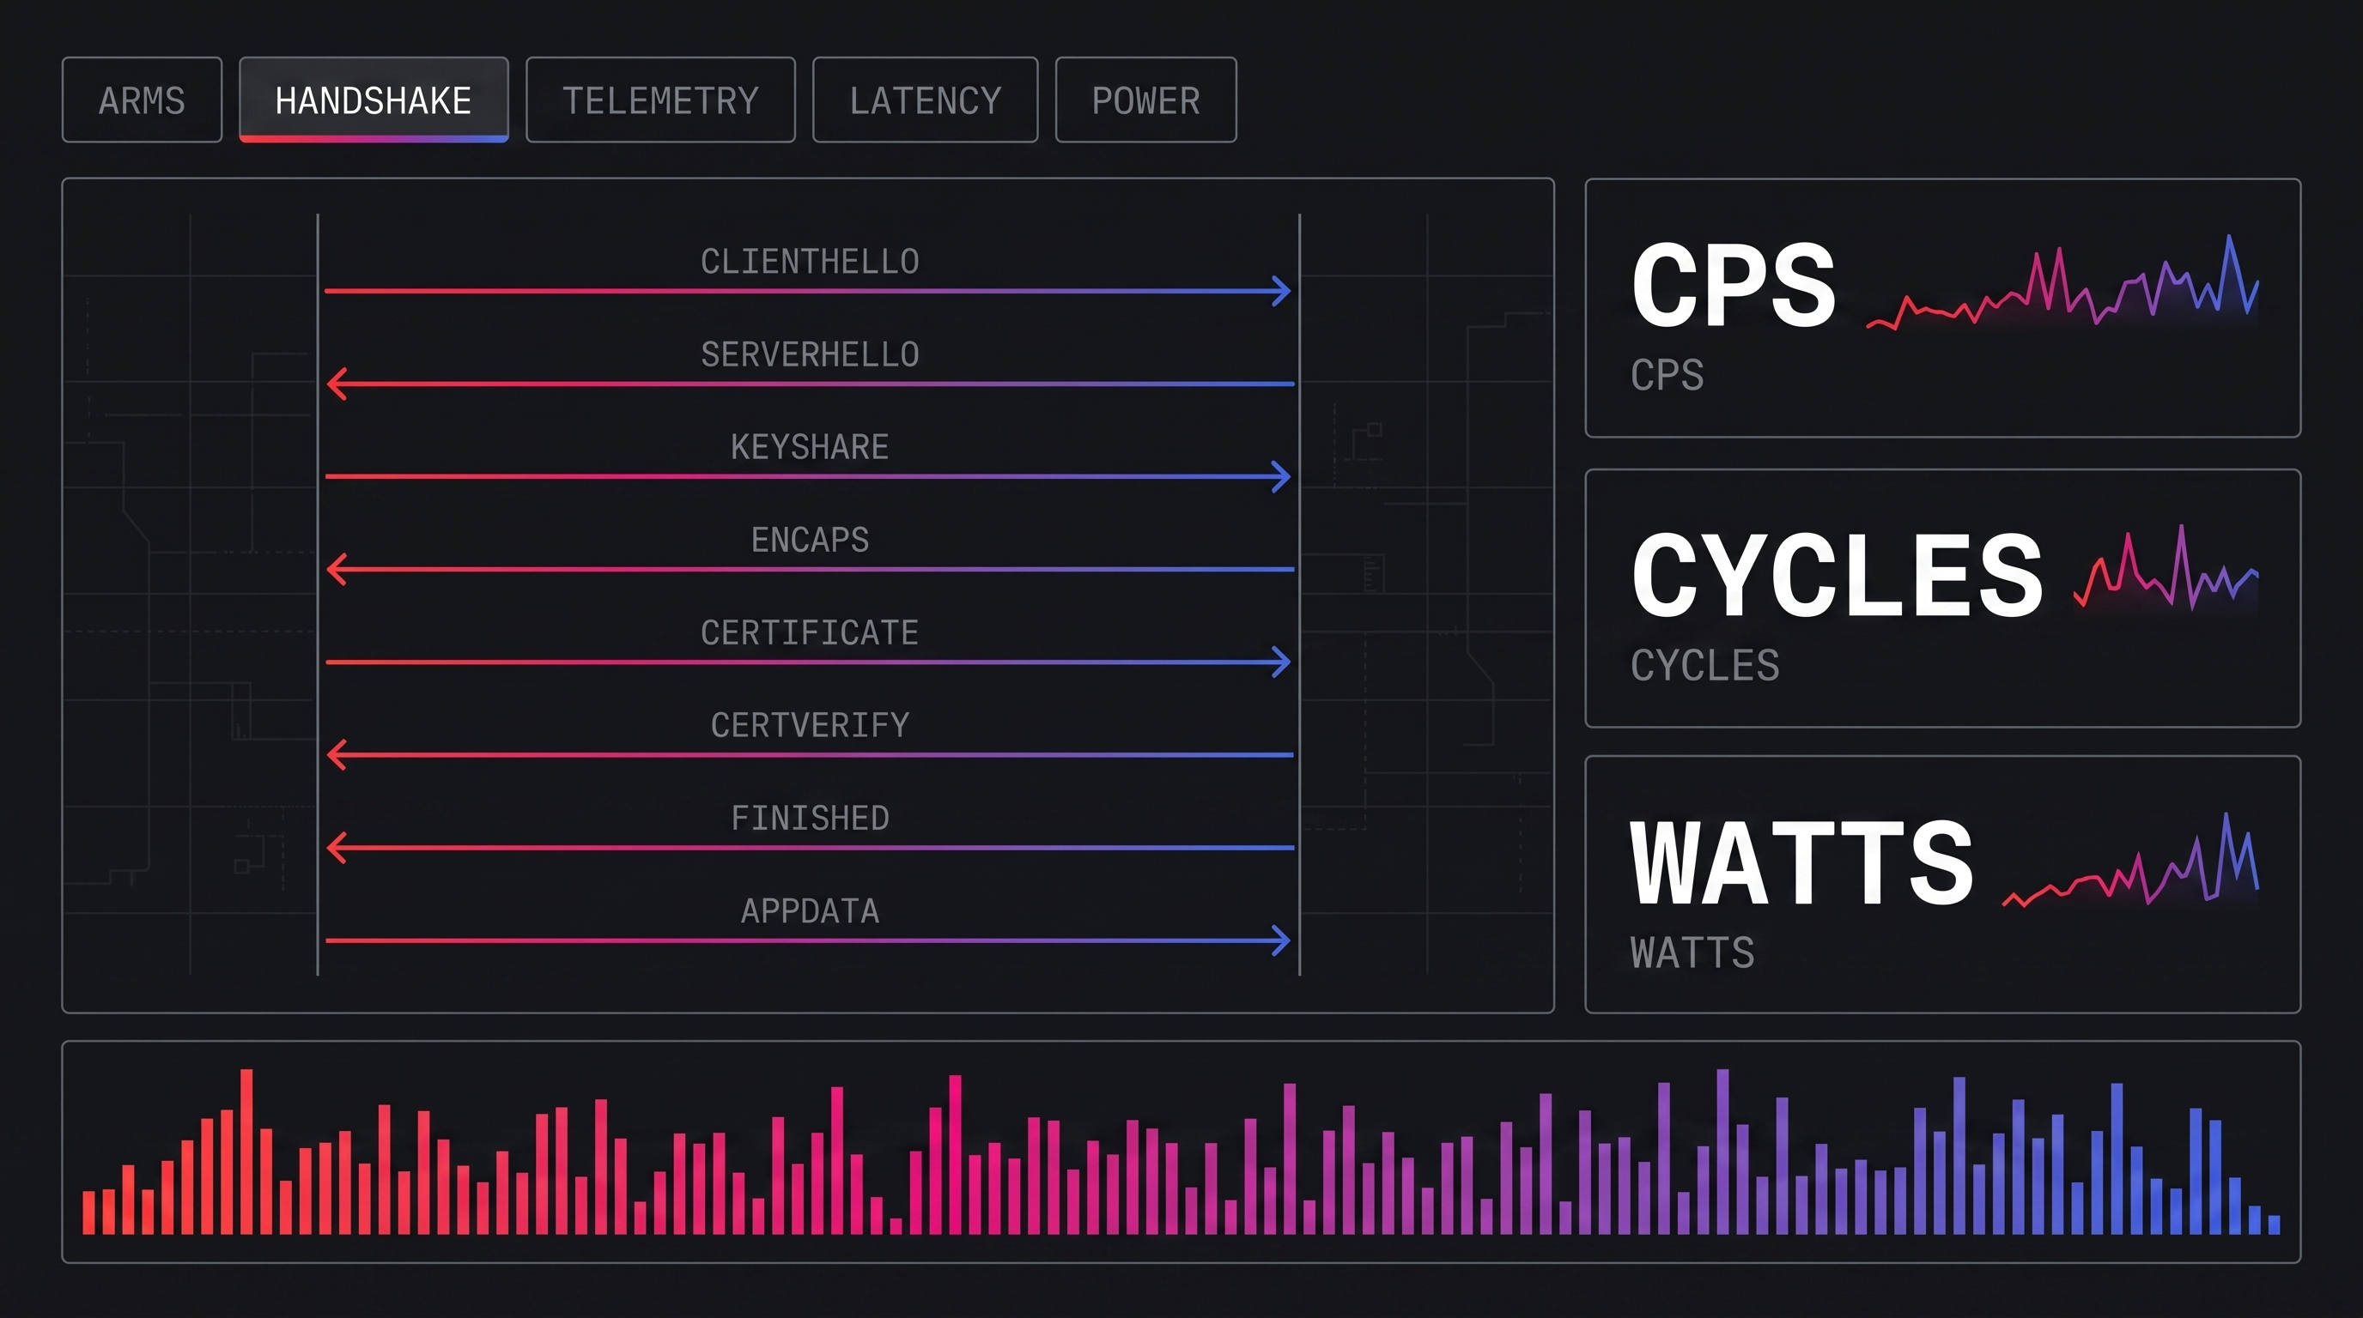
Demo, visual design
Dark instrumentation surface, hairline rules, gradient reserved for data
Design rules
Square corners and hairline rules, no card shadows
Gradient carries data only, never decoration
One numeral per metric panel, unit set beside it
Sequence view reads top to bottom, one row per step
Colour is always paired with a shape so it is never the only cue
Monospace for every figure so columns align
Notes:
Rendered design study. The shipped page follows this language and the layout on the next slide.

Slide 19
Demo, layout and accessibility
Conformance target is WCAG 2.2 level AA
Configuration tabs, A1 to D1
Accessibility requirements
Single tablist, arrow-key traversal, one arm selected at a time
Text contrast at least 4.5 to 1, interface boundaries and graphics at least 3 to 1
Every control reachable and operable by keyboard, with a visible focus indicator
Animation can be paused, and honours the reduced-motion preference
Interactive targets at least 24 by 24 pixels
Meaning never carried by colour alone: each engine also has a distinct shape and a text label
Every graphic has a text alternative, and every chart is duplicated as a data table
All inputs have persistent visible labels, grouped under a legend
Layout reflows to a single column without loss of content or function
Playback: play, step, reset
Speed control
Motion is pausable and steppable
Labelled range input, value echoed as text
Handshake sequence view
Modelled result
One row per step. Engine marked by both colour and shape: square for the accelerator, circle for the core, diamond for the GPU. Row label states the operation in words.
Handshake rate, core time, cycles, latency, device time, rate per watt. Live region announces changes politely.
Per-step table and editable cost model
Every figure in the graphics is also present as text in a table with row and column headers
Conformance is verified before the demo is shared, not after.
Notes:
The duplicate-as-table rule also serves the analysis: anything on screen can be copied into a notebook.

Slide 20
Demo, cost model inputs
Placeholder values, shipped to be overwritten by phase P1 measurements
Input | Engine | Placeholder | Replaced by
Parse ClientHello and transcript | Core | 8 µs | Profiling pass
X25519 ECDH | Core | 45 µs | openssl speed, ecdhx25519
X25519 ECDH, offloaded | Accelerator | 6 µs core, 30 µs device | Accelerator counters plus openssl speed
ML-KEM-768 encapsulate | Core, AVX-512 | 12 µs | openssl speed, kem algorithms
ML-KEM-768 encapsulate | GPU, batched | 3 µs core, 8 µs device | GPU kernel duration
RSA-3072 sign | Core | 1300 µs | openssl speed, rsa3072
RSA-3072 sign, offloaded | Accelerator | 20 µs core, 420 µs device | Accelerator counters plus openssl speed
ML-DSA-65 sign | Core, AVX-512 | 180 µs | openssl speed, signature algorithms
GPU batch fill wait | Queue | 120 µs | Batch size against latency sweep
Core frequency and power per core | Platform | 2.4 GHz, 6.5 W | turbostat during a measured run
Handshake rate is derived, never entered. Core time per handshake is summed from these inputs, so any figure the demo reports can be traced back to a measurement or to a placeholder.
Notes:
Every row without a real measurement behind it stays visibly marked as a placeholder in the page itself.

Slide 21
Phases and deliverables
Instrumentation is validated before any comparative number is produced
Bring-up
Deliverables
0
Stack installed and version-pinned. Telemetry pipeline validated against a known load. Sampling overhead quantified. Idle baseline captured.
Run manifest per run, capturing every version and firmware setting
Raw telemetry in a columnar store, one row per sample per counter
Primitive cost table for the target host
Per-arm results with median and interquartile spread
Derived metric notebook, reproducible from raw data
Two-page findings memo with the four questions answered
Companion demo page, cost model loaded with measured values
Primitives
1
Per-operation costs for every algorithm in the matrix, on the target host. Establishes the floor that connection-level results must be consistent with.
Handshake and bulk
2
Arms A1, B1, B2 and C1 across all three workloads. Single core first, then socket scale-out.
GPU arm
3
Arm D1 plus the batch size against latency sweep. Reported separately because it changes the latency contract.
A result without its run manifest is not a result and is not reported.
Notes:
P0 exists so that a telemetry defect is found before it contaminates four arms of comparative data.

